Slide 1
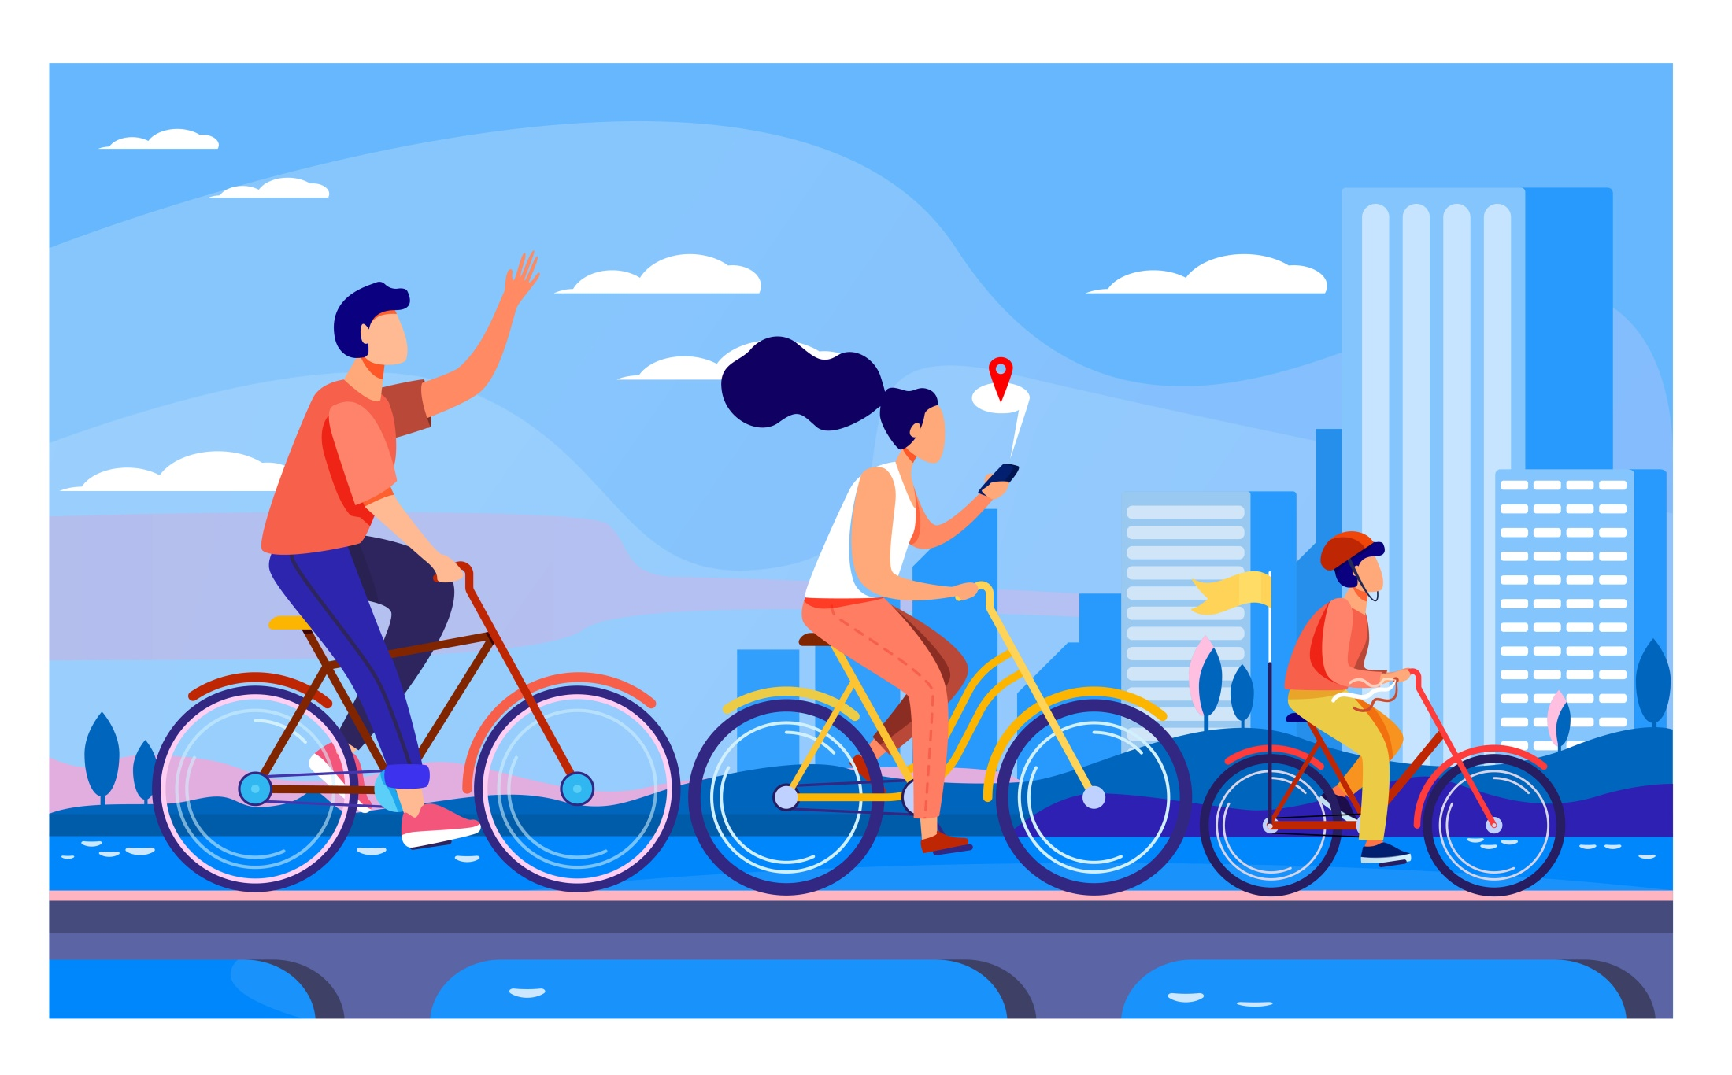
Strategy To Increase The Number Of Annual Memberships
Presented By: Ishita Arora
Last Updated: 09/02/2023

Slide 2
TABLE OF CONTENTS:
What Are We Talking About ?
Data Sources
Business Task
Findings
Conclusion
Recommendations
Appendix

Slide 3

What Are We Talking About ?
Cyclistic
A bike-share program that features more than 5,800 bicycles and 600 docking stations. Cyclistic sets itself apart by also offering reclining bikes, hand tricycles, and cargo bikes, making bike-share more inclusive to people with disabilities and riders who can’t use a standard two-wheeled bike.
Customers who purchase single-ride or full-day passes are referred to as casual riders. Customers who purchase annual memberships are Cyclistic members.
Until now, Cyclistic’s marketing strategy relied on building general awareness and appealing to broad consumer segments. One approach that helped make these things possible was the flexibility of its pricing plans: single-ride passes, full-day passes, and annual memberships.
Cyclistic’s finance analysts have concluded that the annual members are much more profitable than casual riders.
Rather than creating a marketing campaign that targets all-new customers, The project manager believes that there is a very good chance to convert casual riders into members.

Slide 4

Data sources
Data is made available on kaggle.com as a public dataset called divvy-tripdata of the company Lyft Bikes and Scooters, LLC , with the permission of city of chicago under this license
The data is reliable and original , since it is company’s internal data
.
The issues related to bias , credibility and licensing have already been looked upon.
The data used here , is of previous 12 months of 2022.
Reliable data

Slide 5
Business task
To Identify
The difference between the needs of annual members and casual riders who use cyclistic bikes,
In order to design effective marketing strategies aimed at
Converting casual riders into annual members

Slide 6
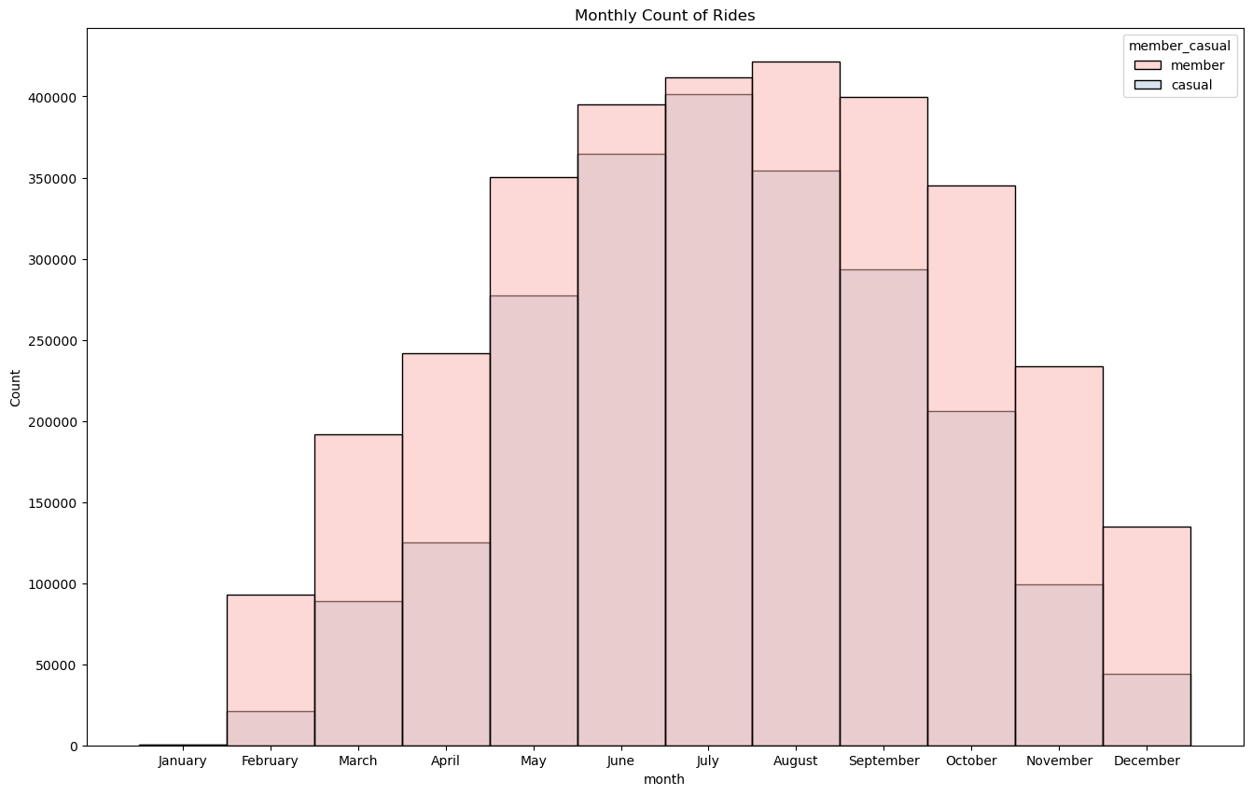
Findings
Total number of rides in each month of the year 2022
For casual riders,the maximum number of rides are taken in july , whereas for members , it is in august.
The maximum number of rides are in the month of july and august overall , with the summer season seeing the no of rides at its peak.
The winter season (december to february , has the least number of rides.

Slide 7
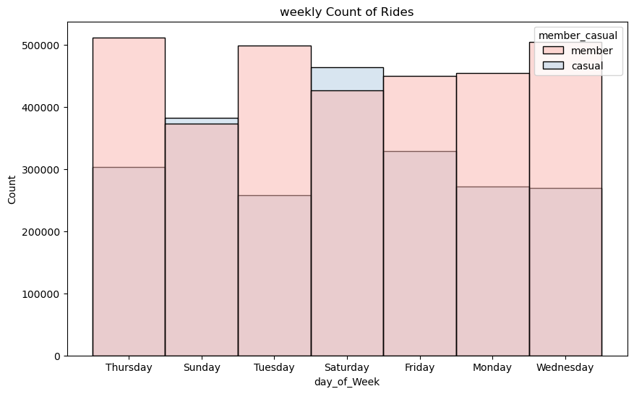
Total number of rides in 12 months by each day of week
For casual riders , there is a peak in the no of rides on weekends
For members , the no of rides taken ,remain more or less consistent throughout the week , with a slight peak on Thursday.

Slide 8
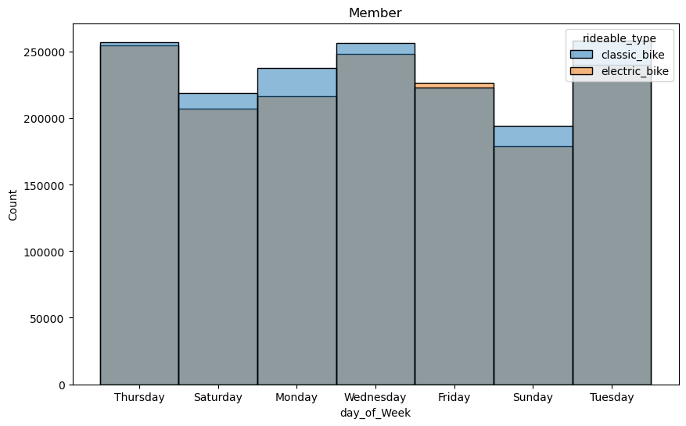
count of annual members on each weekday
From the visualisation , we can clearly see that :
The annual riders are the least active on weekends and mostly use a classic bike.

Slide 9
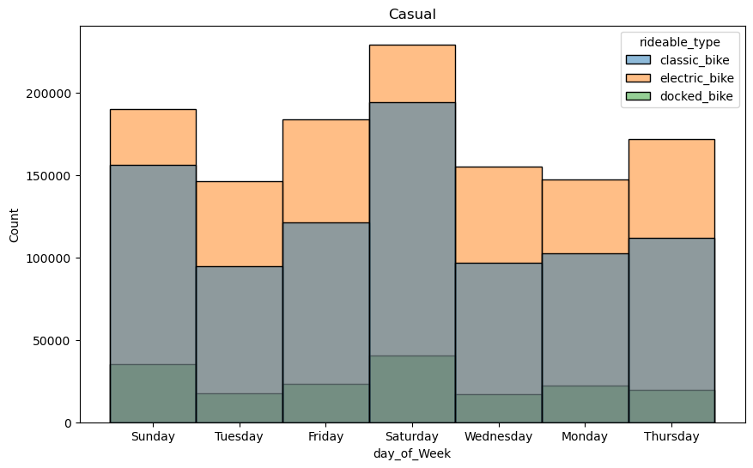
count of casual riders on different weekdays
From the visualisation , we can clearly see that
The casual riders mostly active of weekends with an electric bike.

Slide 10
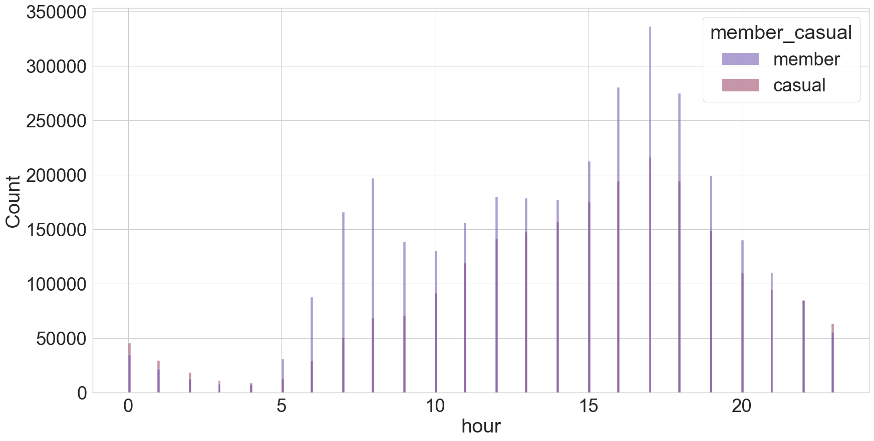
comparative count of casual riders and members by each hour of the day.
From the visualisation , we can clearly see that
the number of riders peak in the evening hours between 3pm to 7pm , with the highest number of riders at 5pm

Slide 11
Conclusion
The summer season , including ,july and august have been found to be the most popular months for riding.
The winter season (december to february , has the least number of rides
For casual riders , there is a peak in the no of rides on weekends whereas for members , the no of rides taken ,remain more or less consistent throughout the week which suggests that the members have a consistent working routine and defined timings in which they use a bike unlike casual riders , who use them on weekends , and mostly at night hours , which suggests that their reasons might be recreational purposes.

Slide 12
Recommendations
Maximum riders in a year come from the six month period of may - October. The marketing team at cyclistic should run promotions during this period of the year to:
Increase chances to convert casual riders into annual members.
Increase visibility among their customers.
The company can introduce a better and affordable pricing plan and subscription model with deals, discounts, or promotions for new members , in order to attract casual riders towards the annual membership.
Also , the promotional campaigns should be held in the evening hours between 3pm to 7pm , in which the number of riders are maximum , in both groups , as seen from the visualisation.

Slide 13
Appendix
Additional links
Data source
License
Documentation of changes made to the dataset
Data cleaning and analysis

Slide 14
Thank You
For Watching

